Slide 1


Temporally and Contextually Dependent Coupling of the HPA and HPG Axes
Andrew Dismukes^{1,2}
Elizabeth Shirtcliff¹
1
2
Notes:
Gonna talk about some of the things that influence coupling, like others have done, and going to really focus in on time.

Slide 2
Organization
Overview of coupling
Acute Stress
Day-Long Stress
Long Term Stress
What does it all mean?

Slide 3

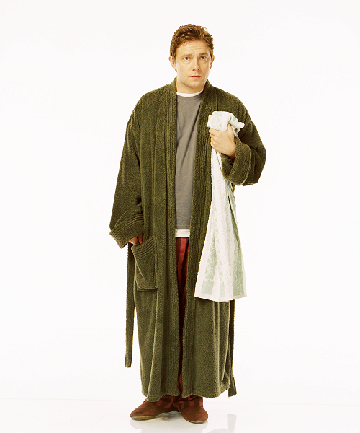

Overview
Hypothalamus
CRH
GnRH
Pituitary
ACTH
LH, FSH
Adrenal
Gonads
Cortisol
Testosterone
Notes:
Lets start with what the hpa and hpg axes are
Follow pathways
Cort: stress responsive cope with the needs of the context,
Testo: motivation to act, challenge, dominance
Much like the beginning of the book, in the beginnign we didn’t consider that these hormones could get along
Based out of the

Slide 4
Overview
HPA
HPG
Follows a pattern of low activity through childhood and activation during adolescence (Gunnar et al., 2009; Dahl and Gunnar, 2009)
Similarly quiescent during childhood (Romeo, 2003) and re-activated during puberty (Ojeda and Terasawa, 2002).
Notes:
What do they normally do over time?

Slide 5

Overview
Stress
Challenge
Notes:
Why would I even think this?
Historical context – these are antagonistic systems.
Cortisol is related to stress
Testosterone is related to challenge
Competition
Sports
Chess
Judo
Soccer
Tennis
Dominoes
These two concepts are not mutually exclusive
If neurobiology allows, there are times when you would expect both axes to be active.

Slide 6
Overview
coupling
HPA axis
HPG axis
Stress Exposure
Adolescence

Slide 7
Study Design
Skydiving
MRI/SPIT
Mendota
Acute Stressor
Bivariate Decomposition of Reactivity
Short Term Stressor
Bivariate Decomposition of Short-Term Stress
Long-Term Stressor
Bivariate Decomposition of Long-Term Stress
Notes:
If they are gonna work together, when are they going to do it, and what sort of time courses will this occur over?

Slide 8
Analytic Strategy
Hormones nested within Individuals – use Hierarchical Linear Modeling
Conserved elements between all studies:
Cortisol is the outcome
Testosterone or DHEA is a predictor in the base model
Specific unique base model for each study

Slide 9


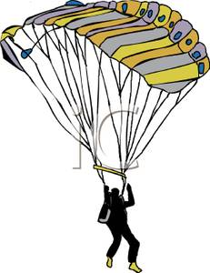
Acute Stress: The skydiving Study
N = 44, 32:12 male:female ratio, average age 29.6 (SD 9.6)
Samples at arrival, takeoff, landing, 15 minutes after landing, 1 hr. after landing.
Included Experienced and Novice jumpers
Takeoff!

Slide 10
Acute Stress: Results
Hormone | Coupling Parameter
Testosterone | .652***
DHEA | .633***
***p<.001
Predicted Cortisol = B₀ + B₁*JB + B₂*HORMONE + B₃*TBJ + B₄*TAJ
*Control terms are loaded on level 2

Slide 11

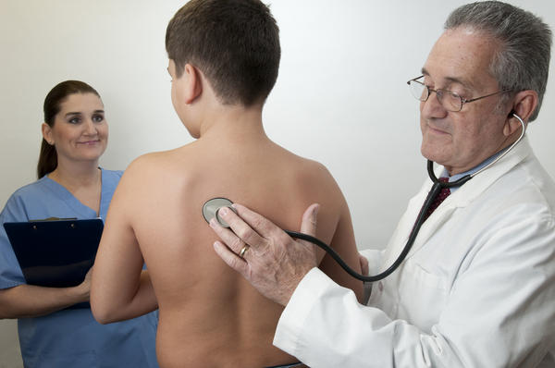
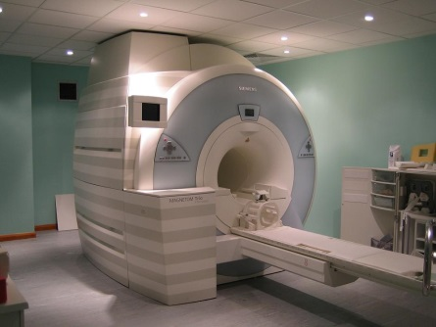


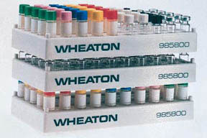
Short Term Stress: The MRI/SPIT Study
N=120 (42 Abused, 78 Control)
Lab Day (Transient Stress)
Home and School Day
Samples collected a) upon awakening, b) mid-morning, C) prior to lunch, d) mid-afternoon, e) before dinner, f) before bedtime
32 Samples of cortisol and testosterone for each kid
Arrive at 9 a.m.
Physical Exam/Puberty Assessment
MRI
Afternoon
LSI
Questionnaire Packet
Saliva collected a)upon arrival, b)after puberty assessment (10:20), c) before MRI (11:04), d) after MRI (12:14), e) after lunch (13:37), f) after interviews (15:30), g) before dinner (17:35), h) at bedtime (21:06)

Slide 12
Short Term Stress Results
Hormone | Coupling Parameter | Interaction Term
Testosterone | -.090* | .010*
DHEA | -.019 | .004
*p<.05
LNCORT_{ijk} = π_{0jk} + π_{1jk}*(TSW_{ijk}) + π_{2jk}*(TSW_SQ_{ijk}) + π_{3jk}*(TSW_CUB_{ijk}) + π_{4jk}*(TSNOONRE_{ijk}) + π_{5jk}*(LNTEST_{ijk}) + π_{6jk}*(LOC_SCH_{ijk}) + π_{7jk}*(LOC_LAB_{ijk}) + π_{8jk}*(INTXTEST_{ijk}) + e_{ijk}
Dismukes et al, under review
Notes:
----- Meeting Notes (3/4/15 11:08) -----
change header, hae trnsition

Slide 13
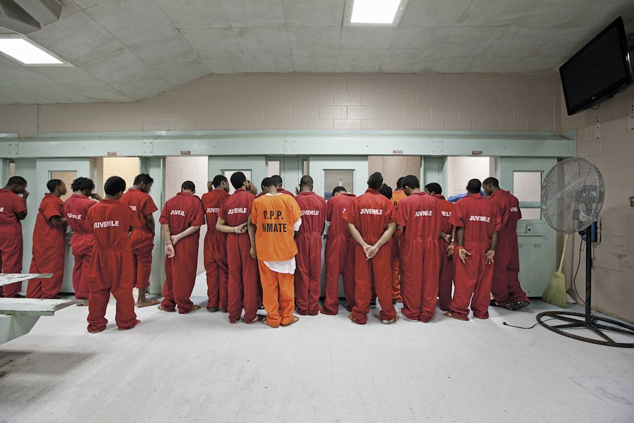
Long Term Stress: Mendota Research Design
50 adolescent male subjects from Mendota Juvenile Treatment Center in Madison, WI.
Hormones
Waking
45 minutes after waking
Before Lunch
Before Dinner
Bedtime
Collected over 2 consecutive days
Daily Diary documented ‘in the moment’ effects
Measures:
Life Stress Interview
Psychopathy Checklist – YV
Questionnaire Packet:
Stress
Callous Traits
Family History
Demographics
Notes:
50 male adolescent subjects

Slide 14
Long Term Stress: Results
 | Coupling Parameter
L2 Variable | DHEA | Testosterone
Abuse Factor | .531*** | .160*
LSI - Lifetime | .040+ | ---
LSI - Chronic | .016 | .039+
LSI - Family | --- | .024*
LSI - Peer | -.019 | .161*
CTQ - PA | -.003 | .035
CTQ - PN | .001 | .052*
Cortisol = B₀ + B₁*CAR + B₂*TSW + B₃*Hormone + R_{ij}
B₀ = G₀₀ + U₀
B₁ = G₁₀
B₂ = G₂₀ + U₂
B₃ = G₃₀ + G₃₁*Stress Variable + U₃
Dismukes et al, 2014

Slide 15
Conclusions: What does it all mean?
Across all three studies there is a pattern of synchrony between HPA and HPG Axes, influenced by context and manifesting across different time scales
This is a new way of thinking about these two axes, that allows for more flexibility than previously considered.
These hormones have behavioral correlates; understanding their patterns helps us understand their contributions to health outcomes

Slide 16
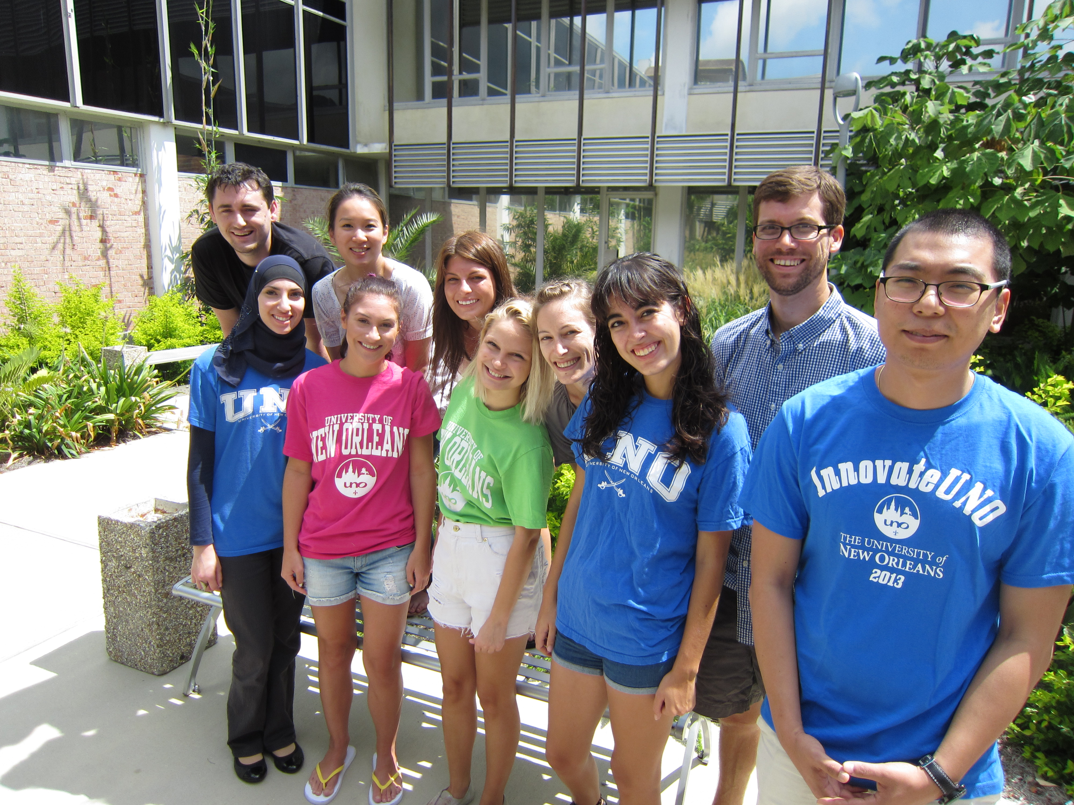
References and Thanks
Thanks:
Stress Physiology in Teens Lab at Iowa State University
Behavioral and Neurodevelopmental Genetics Lab at Tulane University
References:
Dismukes, A. R., Johnson, M. M., Vitacco, M. J., Iturri, F., & Shirtcliff, E. A. (2014). Coupling of the HPA and HPG axes in the context of early life adversity in incarcerated male adolescents. Developmental psychobiology.
Dismukes, A.R., Shirtcliff, E.A., Hanson, J.M., Pollak, S. (in press) Context Influences the Interplay of Endocrine Axes Across the Day. Developmental Psychobiology

